Slide 1

SNU Business School
비즈니스 클리닉
고객분석
5조
BPT 김홍지 BPT 홍만수

Slide 2
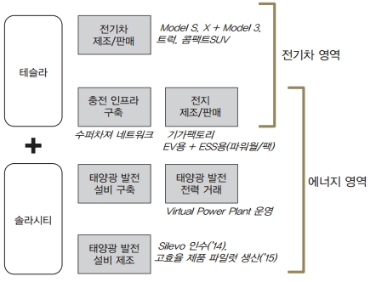
테슬라 비즈니스 모델
Notes:
크게 전기자동차, 에너지 사업으로 구분할 수 있음.
가격이 타사보다 높은 대신 경쟁사의 전기차에 비해 긴 주행거리를 특징으로 한다.
그동안 전기자동차만 다뤘기 때문에 전기자동차 사업의 비즈니스 모델만 다루겠음.

Slide 3
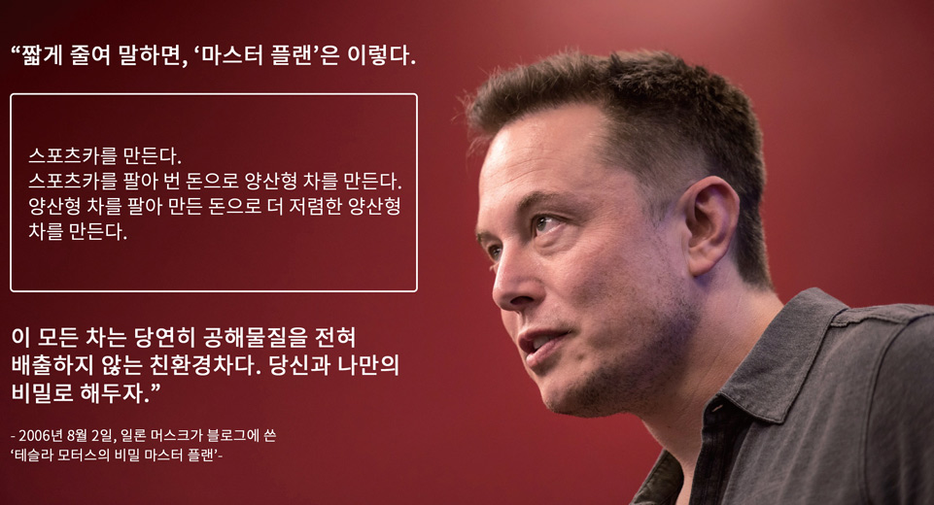
[이코노미 조선] 차소현
http://premium.chosun.com/site/data/html_dir/2016/08/04/2016080402310.html

Slide 4
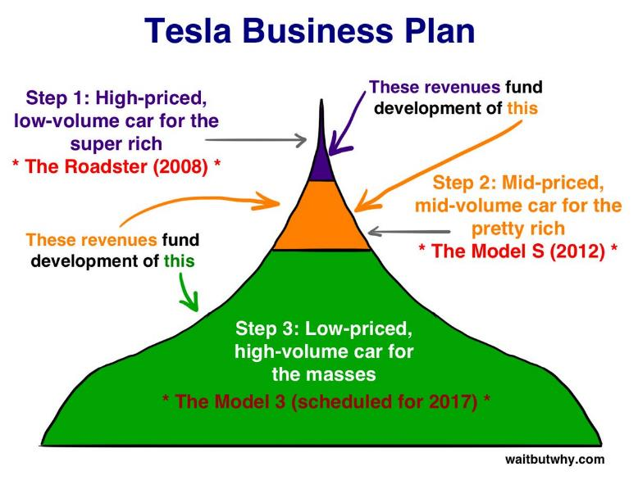

Slide 5
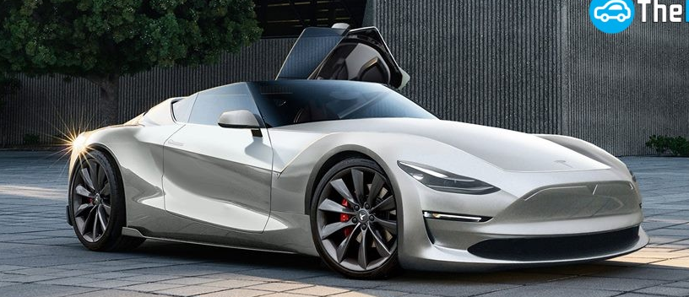
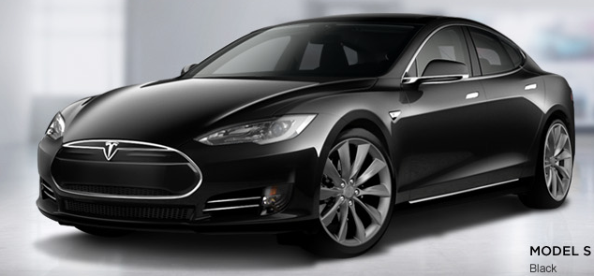
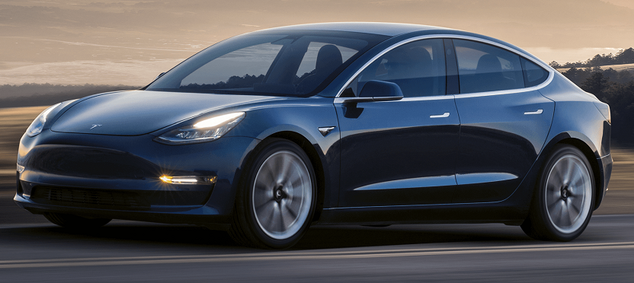
Roadster
Model S
Model 3
Notes:
첫 번째 테슬라 모델은 로드스터 / 전략
: 2인승 로드스터 / 틈새시장 제품을 먼저 도입하여 다음 회사가 거래량을 늘리는데 도움을 줌.
다음 출시 될 모델이

Slide 6
STP 전략 _ STP란?
시장 세분화
목표시장 설정
포지셔닝
제품 역량
제품 이미지
…
성별
연령
소득수준
지역
소비성향
가치관
…
잠재고객
제품 이미지 인식
차별화
제품의 위치 알리기
…
효율성
적합성
성장 가능성
수익 범위
마케팅 비용
…

Slide 7
어필 포인트: 하이엔드부터 진입했다!
Tesla Roadster 2016
Tesla Roadster 2008

Slide 8
어필 포인트: 미래적이다!

Slide 9
어필 포인트: 친환경적인데 좋다!

Slide 10
어필 포인트: 인프라에 투자한다 Super Charger!

Slide 11
타겟과 시장크기
[Statista] 2014년 미 기계애호가와 환경애호가
https://www.statista.com/

Slide 12
STP 전략 _ Step1 Roadster
Segmentation
Target
Positioning
기업 임원 및 기업가
부유한 얼리어답터
하이엔드 전기차
하이엔드
고급 스포츠카
최고급 자동차를
찾는 중년층
Notes:
가격 ) 109000 기본
Target: The original target of the Tesla Roadster included the upper class business executives and others who were looking for a high-end luxury car.
The Tesla Roadster required a large down payment and cost over $100,000, leading it to be unavailable to most consumers who were looking at higher-end cars, or below.
Segment: The segment of the market focused on males who were looking for a luxury sports car that also had an electric motor. The Tesla Roadster was not only efficient, it was also fast and drove like a true sports car. The segment was dominated by males because of the sports car aspect of the brand and the availability.
Positioning: The Tesla Roadster was marketed as a high-end luxury sports car that was fully electric and able to compete with other high level luxury cars performance. While the price was not cheap, it was cheaper than many other high-end sports cars that were on the market at that time. It was not made to compete with the sedans, but with the two-seater car market. The all electric vehicle also provided an incentive to environmental conservative drivers, allowing for zero emissions as they drove.

Slide 13
STP 전략 _ Step2 Model S
Segmentation
Target
Positioning
기술에 관심이 많은
친환경적인 도시 거주자
중산층 계층에 속한
부유층 및 얼리어답터
중년층 베이비붐 세대
성능, 디자인이
우수한
완전한 전기자동차
Notes:
85000 달러 기본
Target: The current customer of Tesla is purchasing the Model S vehicle that is priced at 70k. The customers are successful business executives and entrepreneurs who are also city dwellers that are tech savvy and green friendly. These are wealthy and early adopters whose income levels put them in the upper-middle class segment.
Segment: The segment of the market is individuals looking for a premium luxury car with the added benefit of being fully electric. Tesla is targeting individuals who are upper-middle class baby boomers with typical incomes of over $100,000 which is based on 77% of our buyers falling into this particular segment. Ideally, more males are inclined to purchase our vehicles, so when we market our strategies, we want to keep this in mind when addressing the audience. The majority of the segment is dominantly male.
Positioning: The Model S is posting as a luxury car with great performance that simply has the added benefit of being a fully electric vehicle without sacrificing style and performance. This high-end luxury car is not missing anything from a traditionally European luxury car and that’s how Tesla wants concept to be. They do not want to convey that it is primarily an electric car because at the moment, electric cars do not have a sexy or glamorous reputation because of the cars they call "hybrids" that have horrible performance and style.

Slide 14
STP 전략 _ Step3 Model 3
Segmentation
Target
Positioning
친환경적인 소비자
기술친화적인
소비자
엔트리급
고급 자동차를
찾는 소비자
20대 중반~
40대 초반 Y세대
중산층 근로자
엔트리급
고급 전기자동차
Notes:
35000 달러 기본
New Target Market:
Target: In order for Tesla Motors to keep growing now and into the future, it is going to be important to expand their target market to reach more consumers. Expanding our target market to the generation Y, mid 20’s to early 40’s, middle class working adults, Tesla will be able to utilize their facility while increasing production.
This target market will be pinpointing the young professionals that are looking for an entry level luxury car. According to NADA DATA, the average selling price for a new car in 2011 was around $30,000 which shows that the majority of the consumers are not spending a lot of money on cars.
Segments: We are going to segment the market for our new targets in three categories;
eco friendly consumers,
tech savvy and
entry level luxury cars.
For the eco-friendly consumers, we will be able to reach them by offering a fully electric car that not only has more than double the driving range of the electric competitors, but also has the style and performance that Tesla is known for.
For the tech savvy segment, we can reach them because the fully electric car is a growing technology which most consumers are not currently utilizing. Not only will the car itself be new technology, the interior of the car will really attract the tech savvy consumer with the basic options, as well as the add-ons, that will attract them as well.
The entry level luxury car segment will attract the young professionals that are in the early stages of their careers and who will want to drive a luxury car. By having an entry level price, we will be able to attract more customers which will lead to future sales and brand loyalty.
Positioning: We are going to position this car for the entry level luxury car that also has the added benefit of being fully electric while not losing any performance. Most electric cars are viewed as "unattractive" to younger buyers through lack of design and performance. By creating an entry level Tesla car, we can use our design and technology to change that image. By having an entry level luxury car that is in the $30,000 price range, that also has the benefit of being fully electric, will attract more buyers that are currently looking for electric cars or entry level luxury cars because of the added value of zero emissions, and by having this added value, it will position our brand to save consumers more money than the traditional entry level luxury cars.

Slide 15
감사합니다

